Slide 1


Young Leadership Collaborative
Investing in our future Creating a Culture of wealth

Slide 2
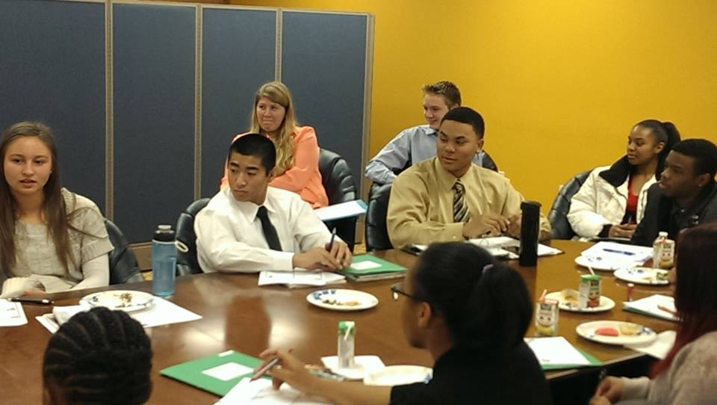
What is Young Leadership Collaborative? (YLC)
What can it do for me?
About
YLC is a Young Adult Program sponsored through the Sacramento Black Chamber of Commerce Foundation (SBCCF) that provides financial literacy to students between 16 and 23. Along with many other contributions from small and large businesses in Sacramento, the SBCCF is able to support this program and provide scholarships to qualifying students. Not all participants have to be interested in having their own business. The curriculum offers business and personal workshops.
Mission
Educate, empower and inspire diverse students
Vision:
Promote opportunities for future generations that create economic vitality
Goals
Increase the number of youth who can develop the economic capacities to succeed in creating and maintaining their own wealth.
Mentorship by Sacramento business leaders.
Create competent, caring and courageous business leaders.
Provide scholarships for participants.
Support the young adults on their next steps after graduation.
Leadership [lēdərˌSHip]
1. The action of leading a group of people or an organization.
2. A first or principal performer of a group.
Saturday Workshop

Slide 3
The Classes and Curriculum
What will be taught? What should I expect?
Structure of the YLC:
The Young Leadership Collaborative will provide students the theoretical and practical tools necessary to be successful in business.
Workshops :
  Credit Management
  Personal Money Management
  Savings/Retirement Planning
  Personal Brand
  Career Exploration and Preparation
  Internships/Projects
  Resume and Interview Skills
Expected Outcomes:
High School Students:
To create real-life learning experiences that provide knowledgeable skills and abilities that build entrepreneurial and independent confidence and competence.
College Students:
To prepare students for the reality of tomorrow’s markets, YLC will provide an understanding of the social, cultural, environmental and economic perspectives required for business success in a competitive environment.

Slide 4
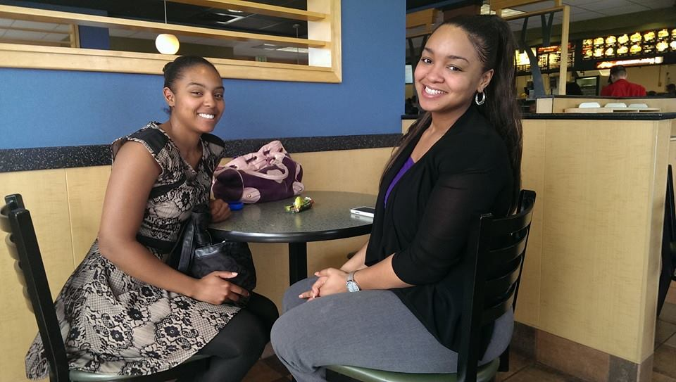
How can I get involved?
What do I need to do?
Eligible Participants
You must be 16-23 year olds. If selected into the YLC, the student must commit to attend all seven sessions and study groups. You must have a willingness to participate in SBCCF Activities. Community engagement is key and strongly encouraged. Students must be willing to work with a mentor. Orientation is mandatory.
The Process
SBCCF will be taking applications from April- October 15th. Applications must be received by the SBCCF or given to the recruiting member for submission.
Group interviews will be held Saturday, November 2nd. The following week, students will be notified of their status. SBCCF will enroll up to 22 students for the 2019-2020 class. Please ensure your application is completed fully before submission.
Once I'm in
Once you are selected, an orientation will be held on December 7, 2019, from 9am – 11am, for students and parents. On December 12, 2019, the 34th Annual Installation and Business Awards Luncheon, held by Sacramento Black Chamber of Commerce Foundation, will introduce the class of 2020, to the community. Classes begin in January 2020, and ends in April/MAy 2020.
Collaborative [kə-​ˈla-​bə-​ˌrā-​tiv]
1. Produced or conducted by two or more parties working together.
2. To work jointly with others or together especially in an intellectual endeavor.
McDonalds Field Trip

Slide 5







YLC STEERING COMMITTEE
Who can I contact?
Committee members that are here to help and advise
Azizza Davis Goines - Executive Director ● Sacramento Black Chamber of Commerce Foundation
David Inniss - Interim President ● Align Capital Region
Elise Schexnayder - YLC Facilitator
Gail Jones - Human Resources Expert Contributor ● VSP Global
Gina Richardson - Financial Education Specialist ● SAFE Credit Union
Joel Powell - Dean ● Cosumnes River College
Monique Anderson - Director ● Portfolio Project Management ● VSP Vision Care
In collaboration with
Our supportive sponsors: We Thank You

